Slide 1
FL-Home System Application

Slide 2
Problem & Motivation
Senior citizens, who are often unfamiliar with the complexities of modern cyber security, are particularly vulnerable to cyberattacks.
  Phishing
  Malware
  Identity theft
  Etc.
These vulnerabilities not only compromise their personal information but also pose significant risks to their financial and emotional well-being.
There is an urgent need for accessible and user-friendly tools that can safeguard this demographic from malicious online activities.

Slide 3
Solution & Novelty
A user-friendly app designed to monitor and manage smart home systems for senior citizens.
The app provides a centralized platform where users can oversee all connected devices, receive alerts about unusual activities, and control device settings to enhance security.
Security features include automatic updates and encryption of data transmissions.
The smart system securely collects via Federated Learning (FL) and analyzes data with from multiple users to identify common settings, preferences, and needs among seniors with specific health conditions.
Utilizes cloud resources such as AWS or Chameleon Cloud to empower machine learning algorithms, training, and testing.
The app is designed to provide an intuitive interfaces with voice command capabilities, cross-platform support with various IoT applications and systems, and intuitive UI customization to tailor to any user’s appeal and handicap.

Slide 4
Methods: Tech Stack - Main Application
Front End:
  React Native for iOS and Android.
  Electron.js for Desktop.
Back End:
  Django (Python) for backend API and logic handling.
  Apple HomeKit, Google Home, Amazon Smart Home, and other apis
  Database:
    CSV for datasets for training models
    Object based Database
    Firebase real-time database features good for updating smart home settings.

Slide 5
Methods: Tech Stack
Backend System & Algorithms
Cloud Services:
  Chameleon Cloud offloading federated learning and hosting resources
  AWS Lambda serverless function for event driven action, e.g. sending alerts
  AWS IoT Core or Azure IoT Hub for storing IoT information and metrics.
Security and Communication:
  AES-256 to encrypt transmissions
  SSL/TLS to safely transmit data
  Wireshark/Nmap to view into Wi-Fi and monitor network
  Snort or Suricata as a baseline IDS to compare with novelty

Slide 6
Methods: Tech Stack
Backend System & Algorithms Continued
Machine Learning Algorithm
  Federated Learning framework
    TensorFlow Federated, Pysyft, or FLWR as the possible frameworks due to intuitive apis and compatibility. Possibly TensorFlow.
    gRPC for efficient, secure, and scalable communication
  Security
    Adversarial Pre-training
    Secure Aggregation
    Secure Multiparty Computing
    Differential Privacy
  Utility
    Regularization (Kernel Regularizer, Dropouts, BatchNormalization)
    Model Pruning (Tmot, pysyft)

Slide 7
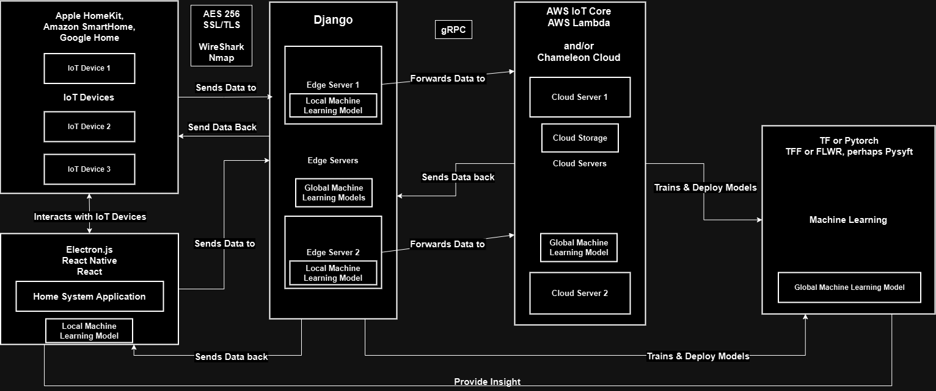
Methods: Infrastructure of Application
Edge Devices
Edge Systems
& Servers
Cloud Systems
& Servers
Machine Learning Framework & Libraries

Slide 8
Planned Experiments
Testing Detection of Network Intrusions with machine learning model and compare against Snort or Suricata.
  Measures:
    Model Performance such as accuracy, precision, recall, loss, ROC.
    Hardware Resource consumption such as CPU utilizing and RAM usage.
Testing Defense Strategies on model against a Network and Data Poisoning attack pipelines.
  Measures:
    Model Performance such as accuracy, precision, recall, loss, ROC.
    Hardware Resource consumption such as CPU utilizing and RAM usage.
    Measures Network Metrics such as latency, RTT, and Bandwidth.
Testing User Validation and Verification of Visuals and Interactions of the Application Menu and Notifications.
  Measures:
    Speed and Performance of the Application and Menu.
    Speed of Comprehension of the menu and interaction.
    User Satisfaction.

